Slide 1
CSC111
Introduction to Computer Science
Course Instructors:
Prof. B. S. Aribisala
Dr. U. C. Ogude
Department of Computer Science
Lagos State of University

Slide 2

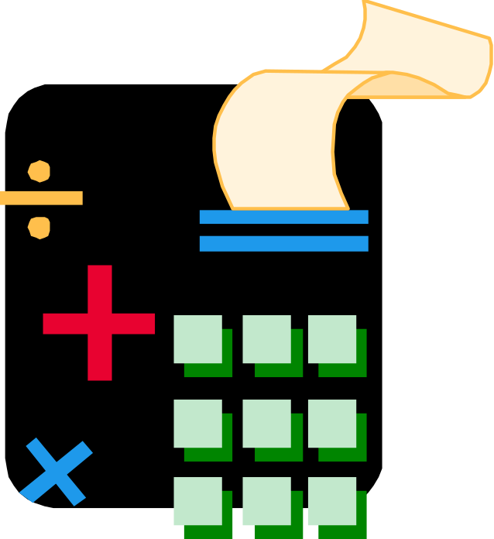
Introduction to Programming
.

Slide 3
Programs
A program is a set of step-by-step instructions that directs the computer to do the tasks you want it to do and produce the results you want.

Slide 4

Programming Languages
A programming language is a set of rules that provides a way of telling a computer what operations to perform.

Slide 5
What Can a Program Do?
A program can only instruct a computer to:
  Read Input
  Sequence
  Calculate
  Store data
  Compare and branch
  Iterate or Loop
  Write Output

Slide 6
Calculate
A program can instruct a computer to perform mathematical operations.
Add 1 to Counter

Slide 7
Store
A program will often instruct a computer to store intermediate results.
Place 1 in Counter

Slide 8
Compare and Branch
A program can instruct a computer to compare two items and do something based on a match or mismatch which, in turn, redirect the sequence of programming instructions.
  There are two forms:
  IF-THEN
  IF-THEN-ELSE

Slide 9
IF-THEN
Entry
Test condition p
false
true
Exit
True statement a

Slide 10
IF-THEN-ELSE
Entry
Test condition p
false
true
“false” statement a
“true” statement a
Exit

Slide 11
Iterate
A program loop is a form of iteration. A computer can be instructed to repeat instructions under certain conditions.
No

Slide 12
Programs are Solutions to Problems
Programmers arrive at these solutions by using one or more of these devices:
Logic flowcharts
Structure charts
Pseudocode
Structured Programming

Slide 13
Logic Flowcharts
These represent the flow of logic in a program and help programmers “see” program design.

Slide 14
Common Flowchart Symbols
Common Flowchart Symbols
Terminator. Shows the starting and ending points of the program. A terminator has flowlines in only one direction, either in (a stop node) or out (a start node).
Data Input or Output. Allows the user to inputdata and results to be displayed.
Processing. Indicates an operation performed by the computer, such as a variable
assignment or mathematical operation.
Decision. The diamond indicates a decision structure. A diamond always has two
flowlines out. One flowlineout is labeled the “yes” branch and the other is labeled the
“no” branch.
Predefined Process. One statement denotes a group of previously defined statements.
For instance, “Calculate m!” indicates that the program executes the necessary commands
to compute m factorial.

Slide 15





Slide 16
Flowchart for a
Cash Register Program
Start
sum=0
Input price
sum=sum+price
More
items?
Yes
No
tax=sum x 0.0725
total=sum+tax
Output sum, tax,
and total
Stop

Slide 17
Psuedocode
This device is not visual but is considered a “first draft” of the actual program.
Pseudocode is written in the programmer’s native language and concentrates on the logic in a program—not the syntax of a programming language.

Slide 18
Pseudocode for a
Cash Register Program
sum=0
While More items do
Input price
sum=sum+price
End While
tax=sum x 0.0725
total=sum+tax
Output sum, tax, total

Slide 19



The Program Development Cycle
WRITE THE CODE
TEST AND DEBUG THE PROGRAM
COMPLETE THE DOCUMENTATION

